Slide 1
Stroke Prediction
Tanish Paruchuri

Slide 2
The Problem
The problem that I will be solving is whether someone is likely to get a stroke based on the features: id, gender, age, if the person has hypertension, if the person has a heart disease, if the person has ever been married, type of work, type of residence, average glucose level, body mass index (BMI), and smoking status.

Slide 3
Motivation
This project excites me because my family has a history of stroke and it is hereditary, so learning more about the factors involved in stroke prediction could prove beneficial once I am closer to the at-risk age. Additionally, I was originally planning to be on the pre-med track. I was accepted into the University of Texas at Dallas as a Neuroscience major, so a disease that affects the brain is particularly interesting to me.

Slide 4
Importance
Stroke prediction is an incredibly useful medical diagnostic tool in order to prevent serious consequences. In the United States, having a stroke is a leading cause of death and long-term disability, “someone in the United States has a stroke every 40 seconds … [someone dies of stroke] every 4 minutes.” [1]. Additionally, stroke-related costs amounted to “nearly $46 billion” [1]. Identifying patients as likely stroke candidates allows them the possibility to reduce their risk factors and circumvent this disease.

Slide 5
Approach
The problem I am solving is a supervised learning binary classification problem. The Machine Learning models that I will use are Naive Bayes, Logistic Regression, K-Nearest Neighbors, Perceptron, Support Vector Machine, Decision Tree, Bagging (Bootstrap Aggregation) Decision Tree, Adaboost, Gradient Boosted Decision Tree, Random Forest, and Neural Network. I will compare the performance of each model and try to explain why some models are performing better than others.
Additionally, I plan to compare the performance of each model on the original feature set, polynomial features, and a subset of the original feature set that excludes any uncorrelated features; however, I may not run all for each model if I conclude that it is unnecessary. I will also use error bars in order to tune the hyper-parameters for each model if applicable.

Slide 6
Evaluation Metric
Performance will be evaluated using accuracy and recall score. I am using accuracy as an evaluation metric since I will be balancing the dataset, thus it will be the most indicative metric of overall model performance. However, recall is the most important metric when it comes to stroke prediction itself. Recall tells us the amount of positive strokes predicted out of all positive strokes. Stroke prediction is something that would generally be used in the medical field. If the model predicts that the person will have a stroke but they aren’t actually at risk, then it is of little consequence. However, if the model does not predict that the person will have a stroke but they actually are at risk, there are substantial consequences as that person won’t know to proactively reduce their risk factors. I decided not to use F1 or ROC AUC as the dataset won’t be imbalanced, they aren’t as indicative of model performance as accuracy, and they aren’t as meaningful as recall.
I’m seeking a model with a recall score of at least 70%, but ideally between 80% and 90% since “anything between 70%-90% is … realistic … [and] consistent with industry standards.” [2]

Slide 7
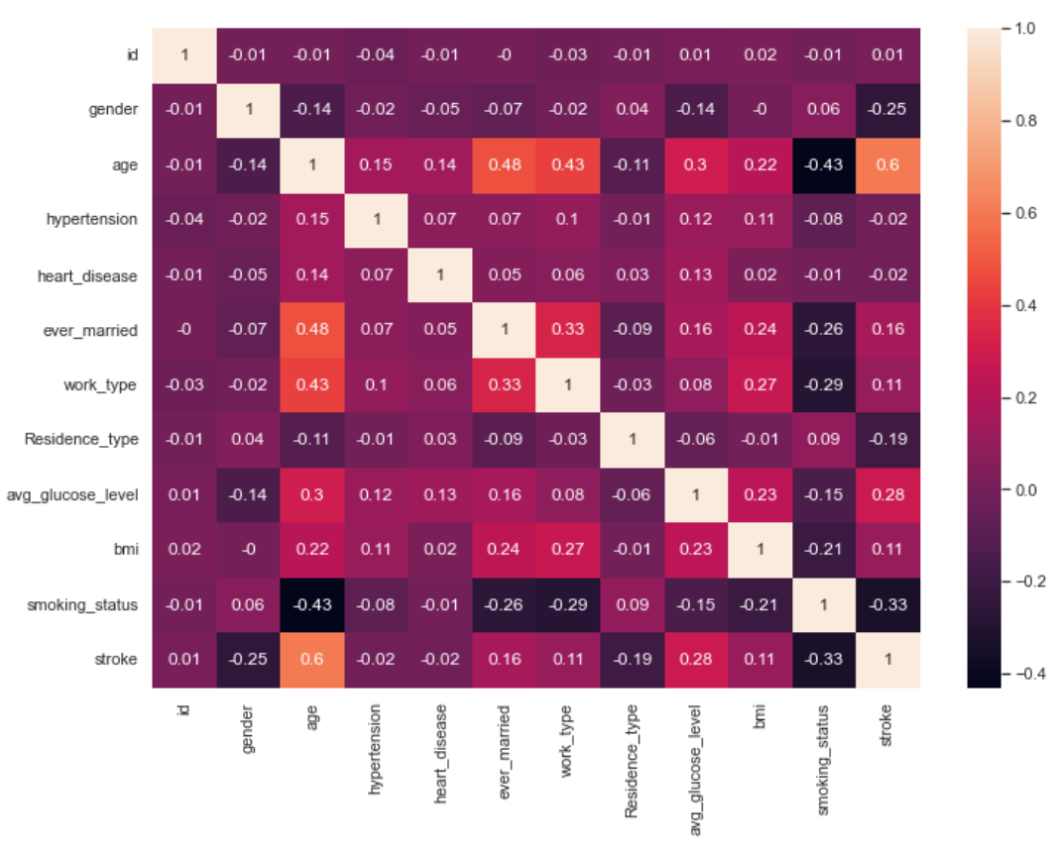
Exploratory Data Analysis
Process:
bmi had 201 NAN values, so I replaced it with the mean of the rest of the bmi values.
I replaced the categorical data such as gender and ever_married with numbers in order to run the models.
The dataset was extremely imbalance, so I decided to use the resampling technique of oversampling via SMOTE [3]
I computed the correlation matrix and plotted some graphs of the features with the highest correlation scores: gender, smoking_status, age, and avg_glucose_level.
Information gathered:
I’m guessing that the hypothesis function should benefit from polynomial features because the density of the positive stroke class on the highest correlated feature, age, is very weak in the lowers ranges before it becomes extremely dense in the higher ranges only. None of the features are highly correlated with each other, so there doesn’t seem to be any redundant features. However, most of the features are weakly correlated with the target. id, hypertension, and heart_disease in particular seem to have next to no correlation with the target.
Correlation Matrix

Slide 8
Model Analysis
Process:
For each model, I ran the original set of data, the original dataset with 2-degree polynomial features, and a subset of features. Each set of data was split into a 70% training and 30% test set. I also normalized all the features using sklearn.preprocessing.StandardScaler since each of the features are on incomparable scales. Also because “some machine learning algorithms benefit from normalization … such as k-nearest neighbors and artificial neural networks” and algorithms that utilize “gradient descents can converge faster.” [4]
I chose to obtain the training and test accuracy to study overfitting/underfitting and the test recall to be the metric used to compare model performance.
I also tuned the hyperparameters for each model. I plotted test recall score graphs for some of the models at differing hyperparameter values in order to do so.
Results:
It doesn’t seem like adding polynomial features was greatly beneficial for any of the models, but it does give a slight edge over just the original features in recall score for most of the models.
The best 4 models are 1-Nearest Neighbor, Support Vector Machines, Gradient Boosted Decision Trees, and Random Forest.

Slide 9
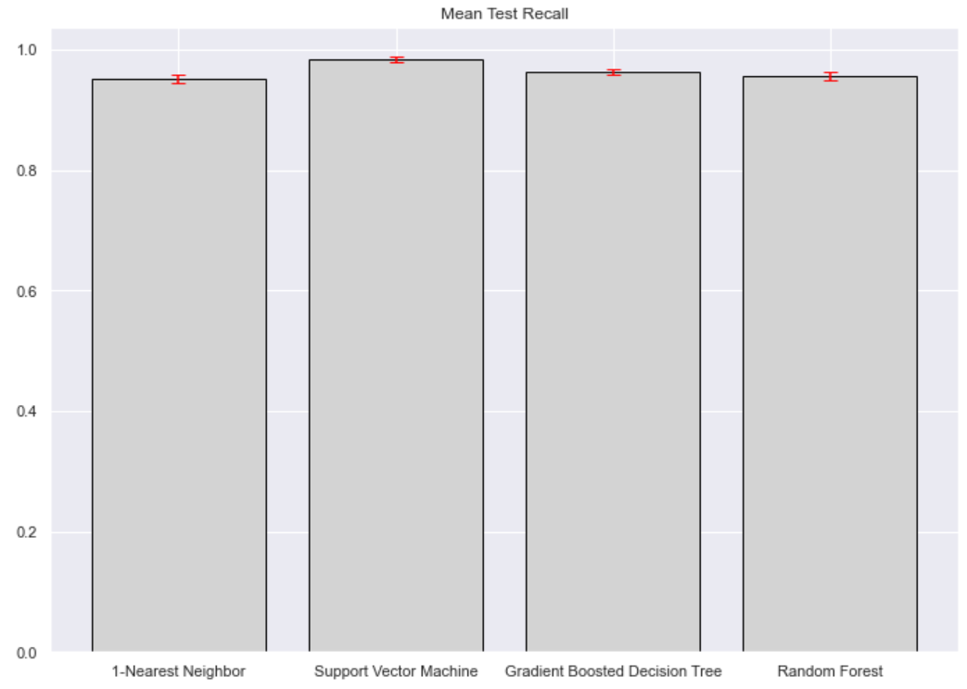
Results
It turns out that using a subset of features performs worse for all models than using all the features. This is very surprising especially since removing just id, which is uncorrelated with every single other feature and the target, decreases model performance.
Based on the cross-validation results, we can see that Support Vector Machines is the most optimal model for stroke prediction using these features. This is evident, since it has the highest mean and the lowest standard deviation test recall score.
The obtained optimal model performance of 0.9840450983343529 far surpasses my initial expectations. This means that the model is excellent, almost perfect, which I thought may be cause for concern. However, it turns out that the model is just decent in terms of overall model performance in being predictive for both test classes.
We could have definitely obtained a model with a much higher mean test accuracy, which is evident by the much higher test accuracy scores in the initial model evaluation phase, but this model is is the most optimal for the problem I am trying to solve.
Lastly, I do believe that the model’s high performance is a result of the non-robust dataset itself. Having only one standout indicative feature makes it significantly easier for the model to predict the positive class.

Slide 10
References
[1] “Stroke facts,” Centers for Disease Control and Prevention, May 25, 2021. [Online]. Available: https://www.cdc.gov/stroke/facts.htm#:~:text=Stroke%20Statistics&text=Every%204%20minutes%2C%20someone%20dies%20of%20stroke.&text=Every%20year%2C%20more%20than%20795%2C000,are%20first%20or%20new%20strokes.&text=About%20185%2C000%20strokes%E2%80%94nearly%201,have%20had%20a%20previous%20stroke. [Accessed March 09, 2022].
[2] K. Barkved, “How To Know if Your Machine Learning Model Has Good Performance,” obviously.ai. [Online]. Available: https://www.obviously.ai/post/machine-learning-model-performance#:~:text=Good%20accuracy%20in%20machine%20learning,also%20consistent%20with%20industry%20standards. [Accessed: May 04, 2022].
[3] Likebupt, “SMOTE,” Azure Machine Learning | Microsoft Docs, 11-Apr-2021. [Online]. Available: https://docs.microsoft.com/en-us/azure/machine-learning/component-reference/smote#:~:text=Synthetic%20Minority%20Oversampling%20Technique%20(SMOTE,that%20you%20supply%20as%20input. [Accessed: May 04, 2022].
[4] “Normalization in Machine Learning,” deepchecks, 05-Aug-2021. [Online]. Available: https://deepchecks.com/glossary/normalization-in-machine-learning/. [Accessed: May 06, 2022].
[5] F. Khani, “Removing Spurious Features can Hurt Accuracy and Affect Groups Disproportionately,” The Stanford AI Lab Blog, 24-Jan-2021. [Online]. Available: https://ai.stanford.edu/blog/removing-spuriousfeature/. [Accessed: May 06, 2022].

